Slide 1
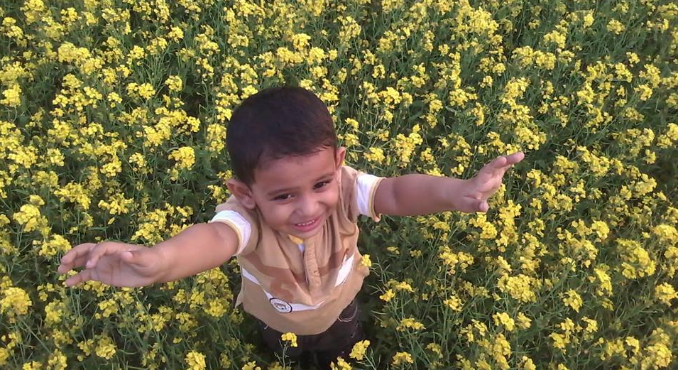
Welcome To English Class
Nizam Uddin Jewel

Slide 2
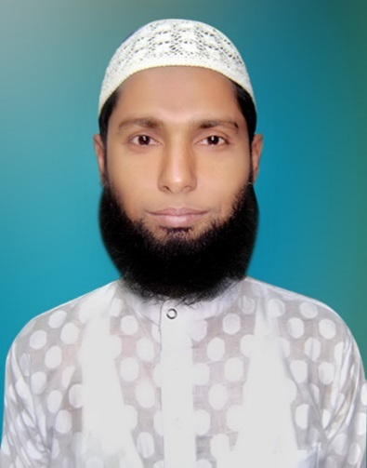
Introductions:
Teachers Identity
Class: five
Sub:English
Unit:1
Lesson:1
Page: 2
Nizam Uddin Jewel
Assistant Teacher
Bahercor gov.primary school
Raipura,Narsingdi
E-mail: nizamuddinjewel@gmail.com
Mobile: 01814902195

Slide 3
Lets listen a song
What about the song?

Slide 4
Learning Outcomes:
Students will be able to :
1.Ask and answer Wh question.
2.take part in conversations on appropriate topics.

Slide 5
Lets watch a video clip

Slide 6
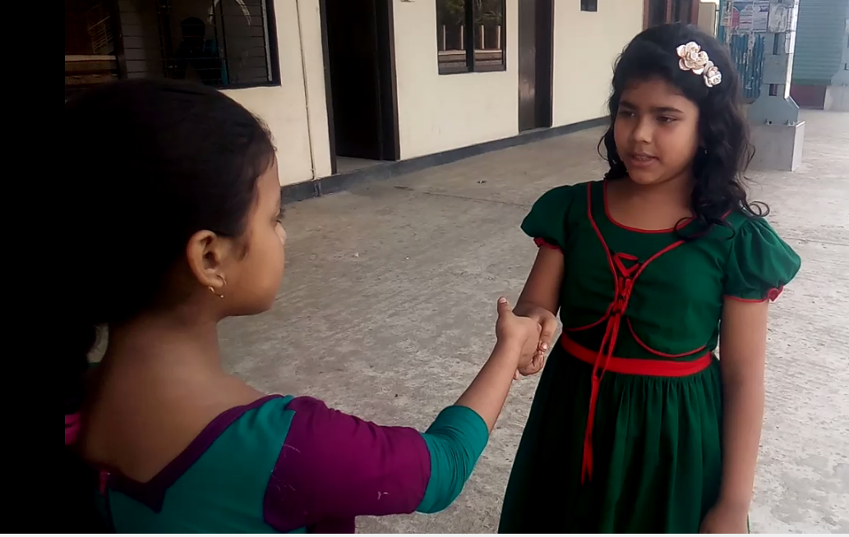
Our train is leaving in 10 minutes.
Thank you.Nice meeting you,Jessica
Have fun in Chittagong.
Really? Where are you from?
Hello! May I introduce myself? I’m Sima.
Where are you going, Jessica?
No, I’m from Sylhet. That’s where we are going.
Have a good journey.
Are you from Dhaka?
I’am from the United Kingdom.
Thanks.Nice meeting you,too,Sima.
I am going to Chittagong. I’m on holiday with my father.
Hi! I’m Jessica.

Slide 7
Let’s listen the lessons audio

Slide 8
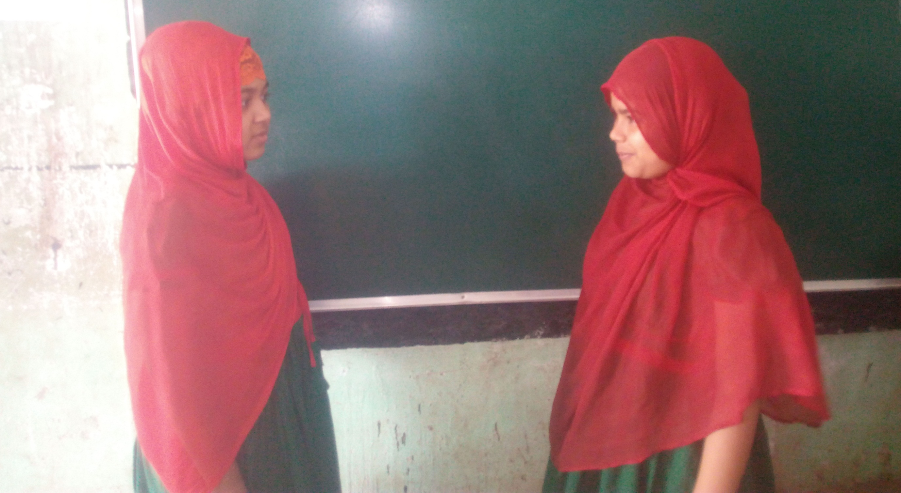
Pair work
Two students will make a pair. They will come in front of the class and make the dialogue about Sima and Jessica.

Slide 9
Individual work
Arrange and rewrite the following words so that they make sense.
Click here for Question
Click here for Answer
1. aydhoil.
1. holiday.
2. are,you,where,going?
2. Where are you going?
3. lalyrae?
3. Really?
4.journey,good,have,a .
4. Have a good journey.
5. aevel
5. Leave.

Slide 10
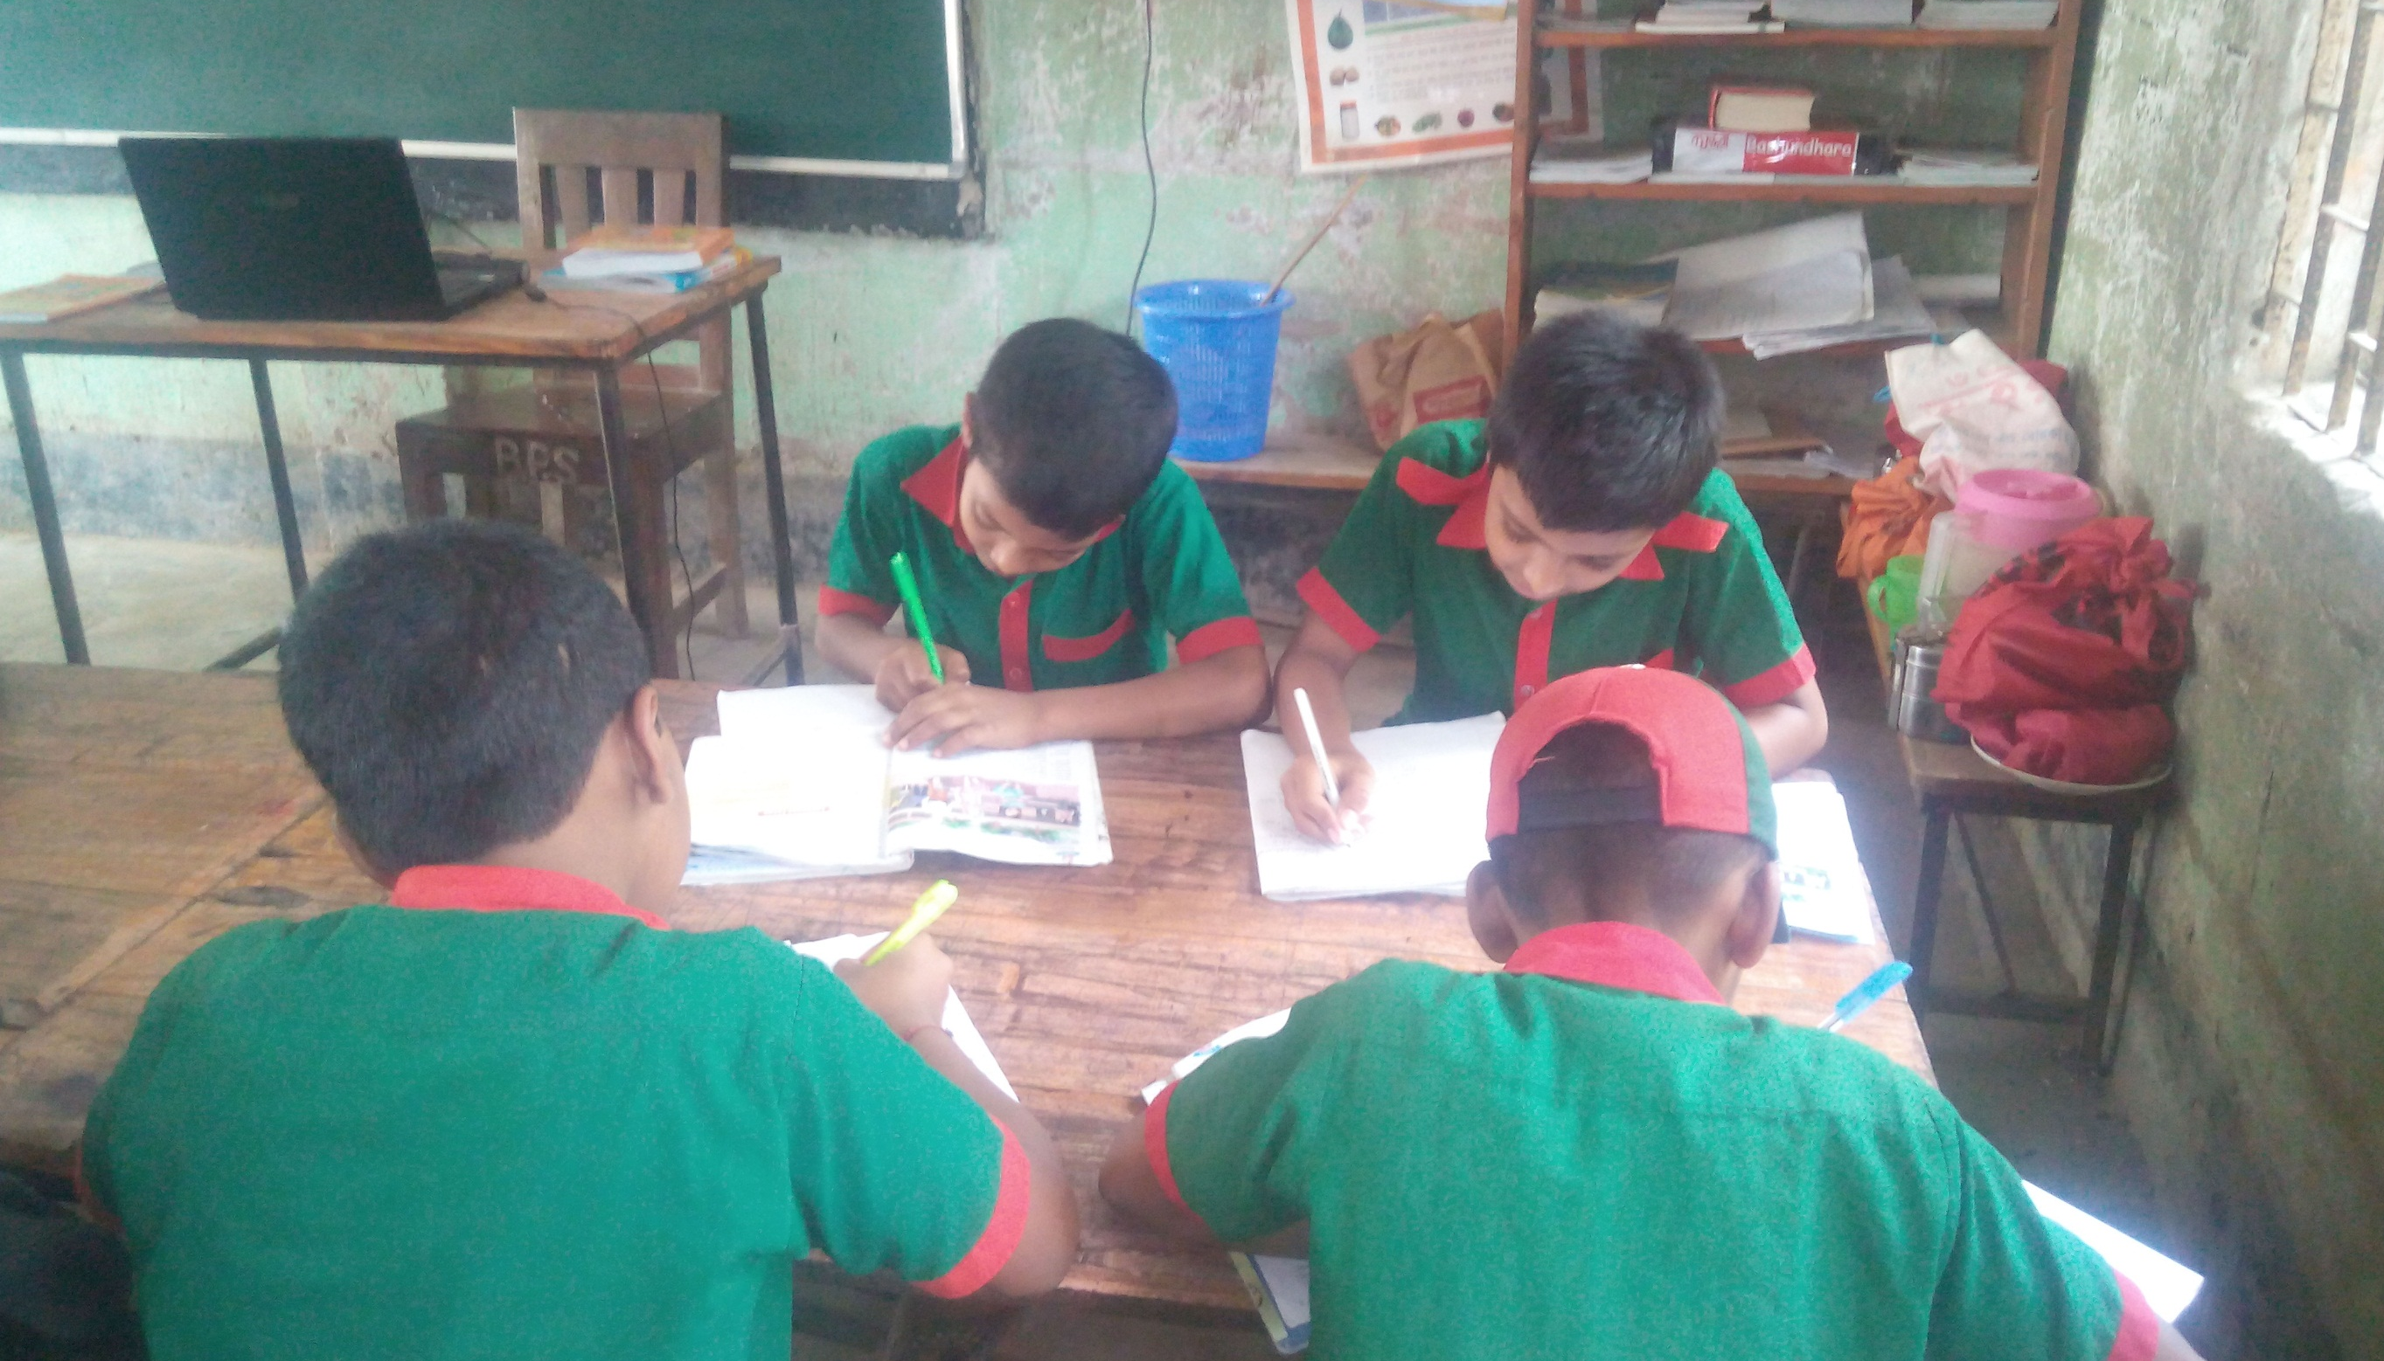
Group work: Four students make a group and try to answer the following questions . Group leader will present the group work.
1) Where is Jessica going?
2)Who with Jessica?
3) Where is Sima going?
4) When is Sima’s train leaving?
5) Where are Sima and Jessica?

Slide 11
SGW
Rewrite using capital letter and punctuation marks.
hello may i introduce myself i’m sima
hi i’am jessica
thanks nice meeting you too sima

Slide 12
Make Wh question from the given statement (by using Who,What,When,Where,Why,Which and How.)
1. Jessica is going to Chittagong.
2. Sima is from Sylhet.
3. Sima and Jessica are in a railway station.
4. Jessica is from United Kingdom.

Slide 13
WCW
Match the words in column A with their meaning in column B.
A | B
1.Introduce | I. To tell other person about own.
2. Fun | Ii. A thing that gives enjoyment.
3. Journey | iii. A trip.
4. Leave | iv. To go away from a place.
5. Live | v. To stay in a place for a long time.
A | B
1.Introduce | I. A trip.
2. Fun | ii. To go away from a place.
3. Journey | iii. To stay in a place for a long time.
4. Leave | iv. A thing that gives enjoyment.
5. Live | v. To tell other person about own.

Slide 14
Evaluation
1. Who introduces herself?
Toma
Raina
Jessica
Sima
2. Where is Jessica from?
Dhaka
United Kingdom
Sylhet
Chittagong

Slide 15
Evaluation
3. When was Jessica going to Chittagong ?
On Friday
On Sunday
On Monday
On holiday
4. When is Sima’s train leaving?
In 5 minutes
In 10 minutes
In 15 minutes
In 20 minutes

Slide 16
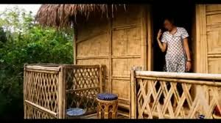
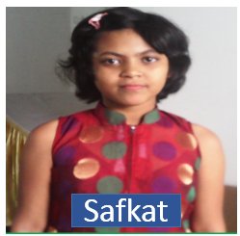
Home
Work
Suppose you are Safkat. You are going toChittagong. You meet with a foreigner. Now make a dialogue with him/her.

Slide 17
Bye, See you!!!

